Slide 1


Dictionaries CS Bridge, Lecture 18

Slide 2
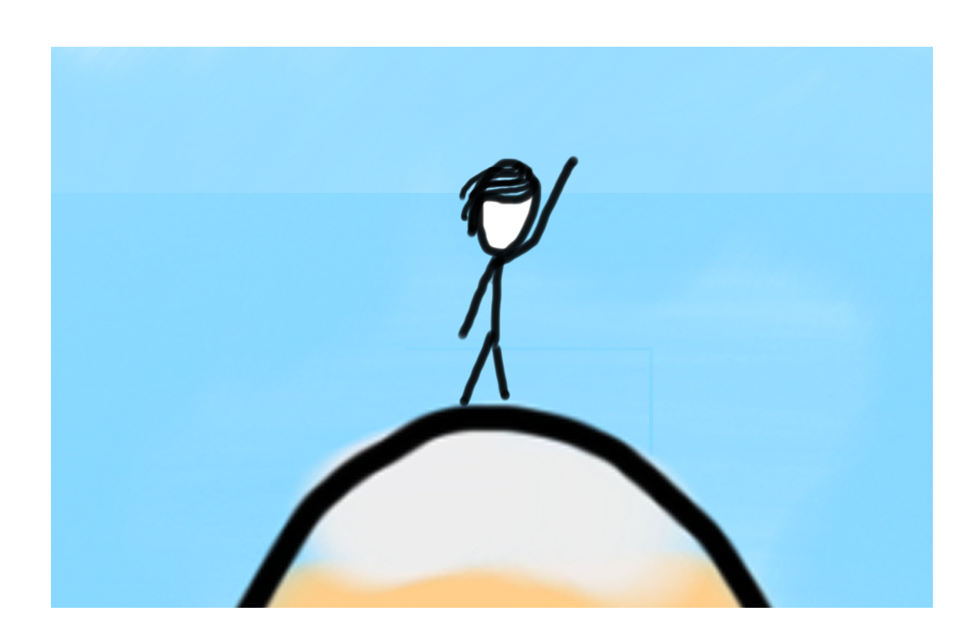

Learning Goals
Learn about dictionaries
Write programs using dictionaries

Slide 3
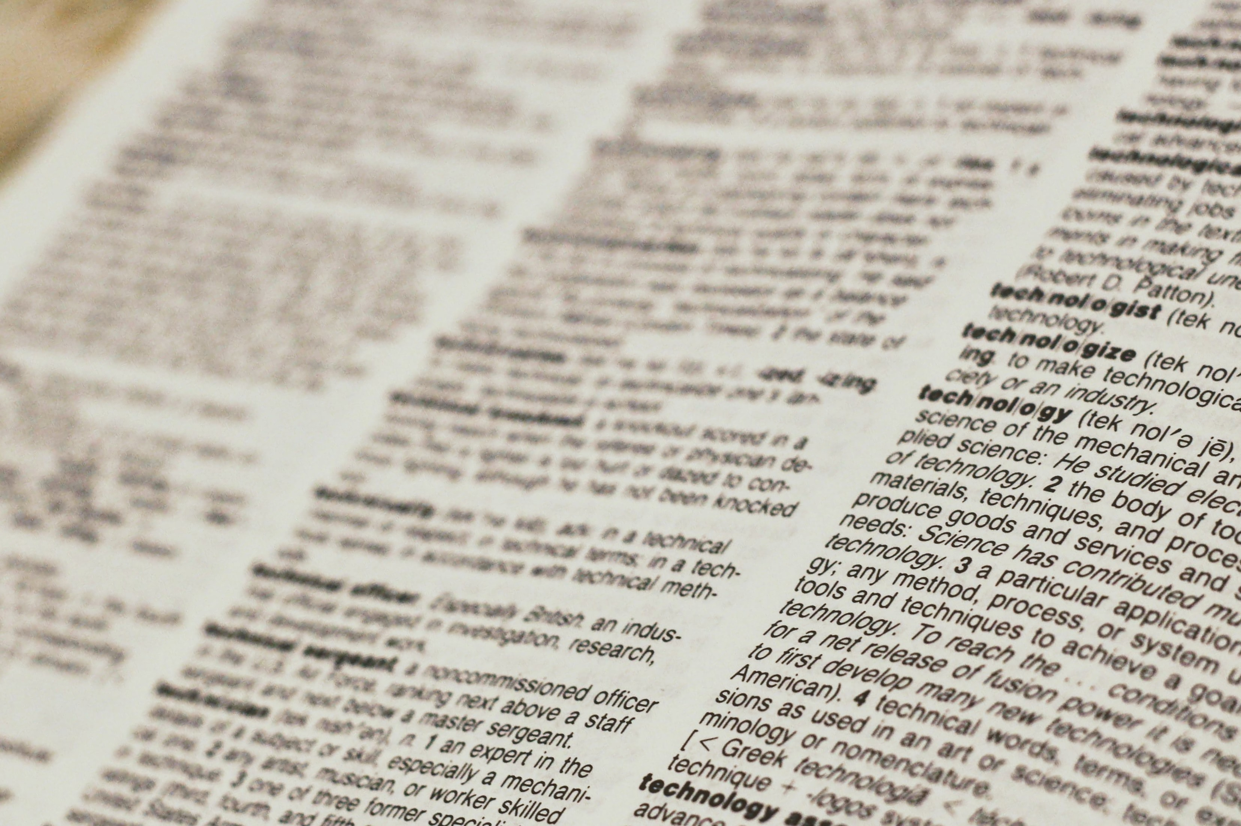
Dictionaries

Slide 4
Recap of Lists
Notes:
Active learning exercise callout

Slide 5
Lists
Help us store a “sequence” of data
Easy to find entry at a specific position
Easy to change entry at a specific position

Slide 6
Lists
Help us store a "sequence" of data
Easy to find entry at a specific position
Easy to change entry at a specific position
animals = ["dog", "horse"]
print(animals[0])
animals[1] = "cat"

Slide 7
Associating Data
What if we want to associate some value with data
Example:
Want to associate student names with their phone #
Want to associate words with their meaning

Slide 8
Associating Data
What if we want to associate some value with data
Example:
Want to associate student names with their phone #
Want to associate words with their meaning
Want to be able to look up the value associated with something

Slide 9
Animals and their diets
Notes:
Active learning exercise callout

Slide 10
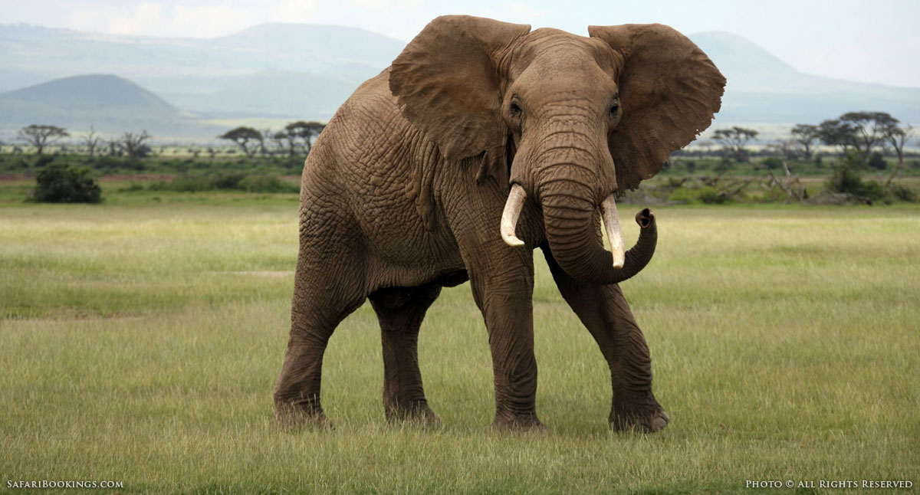
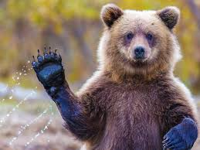
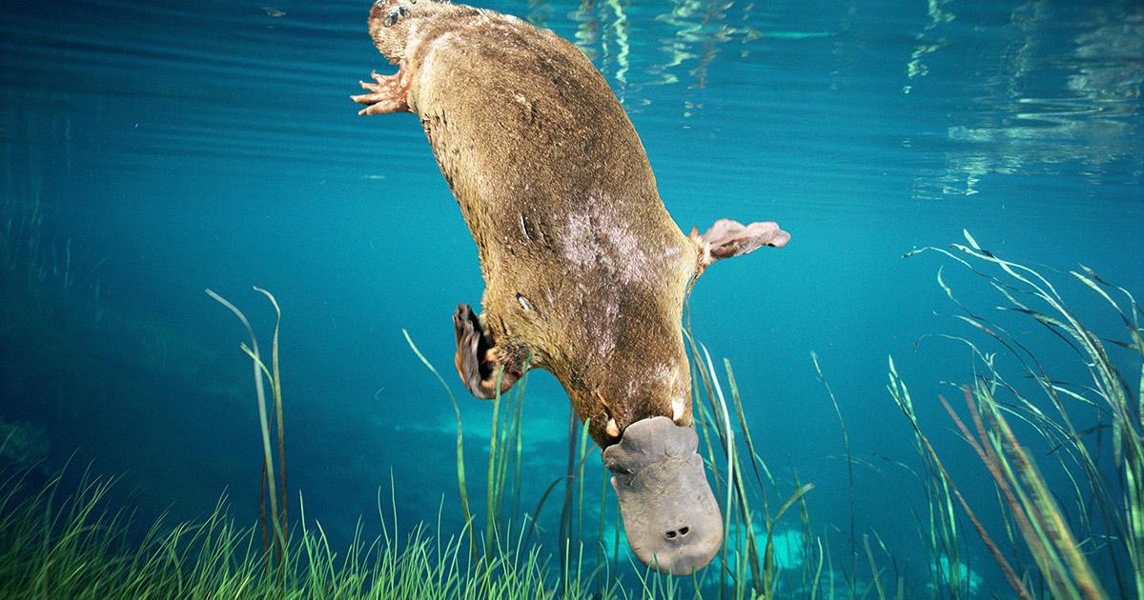
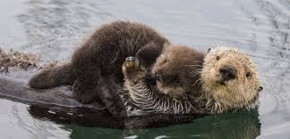
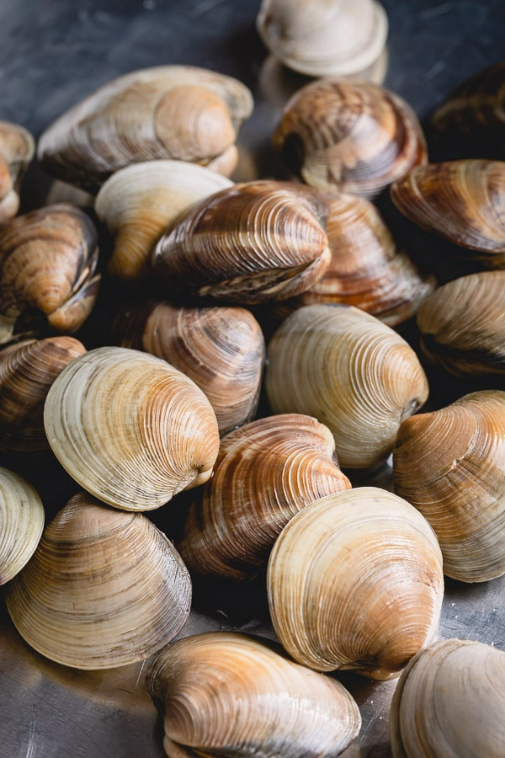
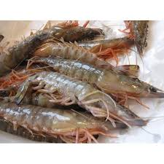
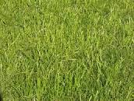
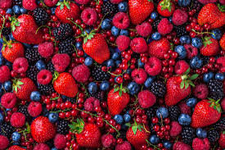
Associating Data
elephant bear otter platypus
clams grass shrimp berries
Notes:
Woodchuck tongue twister

Slide 11
Task - Relating data with each other
Associating Data
['elephant', ‘bear', ‘otter', ‘platypus']
['grass', ‘berries', ‘clams’, ‘shrimp']
Notes:
Woodchuck tongue twister

Slide 12

Task - Relating data with each other
Associating Data
['elephant', ‘bear', ‘otter', ‘platypus']
['grass', ‘berries', ‘clams’, ‘shrimp']
These pieces of information are linked!
Notes:
Woodchuck tongue twister

Slide 13
Task - Relating data with each other
Associating Data
['elephant', ‘bear', ‘otter', ‘platypus']
['grass', ‘berries', ‘clams’, ‘shrimp']
These pieces of information are linked!
Can we store them so they’re associated with each other?
Notes:
Woodchuck tongue twister

Slide 14
Dictionaries!

Slide 15
Dictionaries
Definition
Dictionary
A container data type that maps “keys” to their associated “values”.

Slide 16
Anatomy of a Dictionary
animal_diet = {}
animal_diet["elephant"] = "grass"
animal_diet["bear"] = "berries"
animal_diet["otter"] = "clams”
animal_diet["platypus"] = "shrimp"

Slide 17
Anatomy of a Dictionary
animal_diet = {}
animal_diet["elephant"] = "grass"
animal_diet["bear"] = "berries"
animal_diet["otter"] = "clams”
animal_diet["platypus"] = "shrimp"
animal_diet = {"elephant": "grass", "bear": "berries",
"otter": "clams”, "platypus": "shrimp"}

Slide 18
Anatomy of a Dictionary
animal_diet = {"elephant": "grass", "bear": "berries",
"otter": "clams”, "platypus": "shrimp"}

Slide 19
Anatomy of a Dictionary
animal_diet = {"elephant": "grass", "bear": "berries",
"otter": "clams”, "platypus": "shrimp"}
It is easier to visualize it this way:
dict
keys
values
‘elephant'
‘bear'
‘otter'
‘platypus'
‘grass’
‘berries'
‘clams’
shrimp’

Slide 20
Anatomy of a Dictionary
dict
keys
values
‘elephant'
‘bear'
‘otter'
‘platypus'
‘grass’
‘berries'
‘clams'
‘shrimp’
Each key can store one value

Slide 21
Anatomy of a Dictionary
dict
keys
values
>>> d[‘elephant’]
‘elephant'
‘bear'
‘otter'
‘platypus'
‘grass’
‘berries'
‘clams'
‘shrimp’
Each key can store one value

Slide 22
Get
Anatomy of a Dictionary
dict
keys
values
>>> d[‘elephant’]
‘elephant'
‘bear'
‘otter'
‘platypus'
‘grass’
‘berries'
‘clams'
‘shrimp’
This operation is called ‘‘get’’

Slide 23
Anatomy of a Dictionary
Get
dict
keys
values
>>> d[‘elephant’]
‘elephant'
‘bear'
‘otter'
‘platypus'
‘grass’
‘berries'
‘clams'
‘shrimp’
This operation is called ‘‘get’’

Slide 24
Anatomy of a Dictionary
Get
dict
keys
values
>>> d[‘elephant’]
‘grass’
‘elephant'
‘bear'
‘otter'
‘platypus'
‘grass’
‘berries'
‘clams'
‘shrimp’

Slide 25
Anatomy of a Dictionary
Get
dict
keys
values
>>> d[‘elephant’]
‘grass’
‘elephant'
‘bear'
‘otter'
‘platypus'
‘grass’
‘berries'
‘clams'
‘shrimp’

Slide 26
Anatomy of a Dictionary
Set
dict
keys
values
>>> d[‘elephant’]
‘grass’
>>> d[‘elephant’] = ‘leaves’
‘elephant'
‘bear'
‘otter'
‘platypus'
‘grass’
‘berries'
‘clams'
‘shrimp’
This operation is called ‘‘set’’

Slide 27
Anatomy of a Dictionary
Set
dict
keys
values
>>> d[‘elephant’]
‘grass’
>>> d[‘elephant’] = ‘leaves’
‘elephant'
‘bear'
‘otter'
‘platypus'
‘grass’
‘berries'
‘clams'
‘shrimp’
This operation is called ‘‘set’’

Slide 28
Anatomy of a Dictionary
Set
dict
keys
values
>>> d[‘elephant’]
‘grass’
>>> d[‘elephant’] = ‘leaves’
‘elephant'
‘bear'
‘otter'
‘platypus'
‘leaves’
‘berries'
‘clams'
‘shrimp’
This operation is called ‘‘set’’

Slide 29
Anatomy of a Dictionary
dict
keys
values
>>> d[‘elephant’]
‘grass’
>>> d[‘elephant’] = ‘leaves’
‘elephant'
‘bear'
‘otter'
‘platypus'
‘leaves’
‘berries'
‘clams'
‘shrimp’

Slide 30
Anatomy of a Dictionary
dict
keys
values
>>> d[‘elephant’]
‘grass’
>>> d[‘elephant’] = ‘leaves’
>>> d[‘cat’]
‘elephant'
‘bear'
‘otter'
‘platypus'
‘leaves’
‘berries'
‘clams'
‘shrimp’

Slide 31
Anatomy of a Dictionary
dict
keys
values
>>> d[‘elephant’]
‘grass’
>>> d[‘elephant’] = ‘leaves’
>>> d[‘cat’]
‘elephant'
‘bear'
‘otter'
‘platypus'
‘leaves’
‘berries'
‘clams'
‘shrimp’
KeyError

Slide 32
Anatomy of a Dictionary
dict
keys
values
>>> d[‘elephant’]
‘grass’
>>> d[‘elephant’] = ‘leaves’
>>> d[‘cat’]
‘elephant'
‘bear'
‘otter'
‘platypus'
‘leaves’
‘berries'
‘clams'
‘shrimp’
“get” errors if the key is not in the dict

Slide 33
in
Anatomy of a Dictionary
dict
keys
values
>>>‘elephant’ in d
‘elephant'
‘bear'
‘otter'
‘platypus'
‘leaves’
‘berries'
‘clams'
‘shrimp’

Slide 34
Anatomy of a Dictionary
in
dict
keys
values
>>>‘elephant’ in d
True
‘elephant'
‘bear'
‘otter'
‘platypus'
‘leaves’
‘berries'
‘clams'
‘shrimp’

Slide 35
Anatomy of a Dictionary
in
dict
keys
values
>>>‘elephant’ in d
True
>>>‘cat’ not in d
True
‘elephant'
‘bear'
‘otter'
‘platypus'
‘leaves’
‘berries'
‘clams'
‘shrimp’

Slide 36
Anatomy of a Dictionary
in
dict
keys
values
>>>‘elephant’ in d
True
>>>‘cat’ not in d
True
‘elephant'
‘bear'
‘otter'
‘platypus'
‘leaves’
‘berries'
‘clams'
‘shrimp’
Common pattern: Check if key is present. If it is, do something. If it isn’t, do something else.

Slide 37
Building a Dictionary
>>> d = {}

Slide 38
Building a Dictionary
>>> d = {}
Create an empty dictionary

Slide 39
Building a Dictionary
>>> d = {}
>>> d[‘elephant’] = ‘grass’

Slide 40
Building a Dictionary
>>> d = {}
>>> d[‘elephant’] = ‘grass’
We can add keys using ‘‘set’’

Slide 41
Building a Dictionary
>>> d = {}
>>> d[‘elephant’] = ‘grass’
>>> d
We can add keys using ‘‘set’’

Slide 42
Building a Dictionary
>>> d = {}
>>> d[‘elephant’] = ‘grass’
>>> d
{‘elephant’: ‘grass'}
We can add keys using ‘‘set’’

Slide 43
Building a Dictionary
>>> d = {‘elephant’: ‘grass’}

Slide 44
Types of Dictionaries
So far, we’ve seen dictionaries mapping from strings to strings
This is not the only type of dictionary!
You can map from string/int/float to string/int/float...

Slide 45
Example:
Store names of CS lecturers and their ages
Notes:
Active learning exercise callout

Slide 46
Dictionary Keys
>>> d = {‘Ayca’: 34, ‘Nick’: 28, ‘Ondrej’: 30, ‘Chris’= 29’}

Slide 47
Dictionary Keys
>>> d = {‘Ayca’: 34, ‘Nick’: 28, ‘Ondrej’: 30, ‘Chris’= 29’}
>>> list(d.keys())

Slide 48
Dictionary Keys
>>> d = {‘Ayca’: 34, ‘Nick’: 28, ‘Ondrej’: 30, ‘Chris’= 29’}
>>> list(d.keys())
[‘Ayca’, ‘Nick’, ‘Ondrej’, Chris]

Slide 49
Dictionary Values
>>> d = {‘Ayca’: 34, ‘Nick’: 28, ‘Ondrej’: 30, ‘Chris’= 29’}

Slide 50
Dictionary Values
>>> d = {‘Ayca’: 34, ‘Nick’: 28, ‘Ondrej’: 30, ‘Chris’= 29’}
>>> list(d.values())

Slide 51
Dictionary Values
>>> d = {‘Ayca’: 34, ‘Nick’: 28, ‘Ondrej’: 30, ‘Chris’= 29’}
>>> list(d.values())
[34, 28, 30, 29]

Slide 52
Looping over keys
>> d = {‘Ayca’: 34, ‘Nick’: 28, ‘Ondrej’: 30, ‘Chris’= 29’}

Slide 53
Looping over keys
>> d = {‘Ayca’: 34, ‘Nick’: 28, ‘Ondrej’: 30, ‘Chris’= 29’}
>>> for name in list(d.keys()):
... print(name)
Just a normal list

Slide 54
Looping over keys
>> d = {‘Ayca’: 34, ‘Nick’: 28, ‘Ondrej’: 30, ‘Chris’= 29’}
>>> for name in list(d.keys()):
... print(name)
Ayca
Nick
Ondrej
Chris
Just a normal list

Slide 55
Looping over values
>> d = {‘Ayca’: 34, ‘Nick’: 28, ‘Ondrej’: 30, ‘Chris’= 29’}

Slide 56
Looping over values
>> d = {‘Ayca’: 34, ‘Nick’: 28, ‘Ondrej’: 30, ‘Chris’= 29’}
>>> for age in list(d.values()):
... print(age)
Just a normal list

Slide 57
Looping over values
>> d = {‘Ayca’: 34, ‘Nick’: 28, ‘Ondrej’: 30, ‘Chris’= 29’}
>>> for age in list(d.values()):
... print(age)
34
28
30
29
Just a normal list

Slide 58
Looping over keys and values
>> d = {‘Ayca’: 34, ‘Nick’: 28, ‘Ondrej’: 30, ‘Chris’= 29’}

Slide 59
Looping over keys and values
>> d = {‘Ayca’: 34, ‘Nick’: 28, ‘Ondrej’: 30, ‘Chris’= 29’}
>>> for name in list(d.keys()):
... age = d[name]
... print(name, 'is', age, 'years old.’)

Slide 60
Looping over keys and values
>> d = {‘Ayca’: 34, ‘Nick’: 28, ‘Ondrej’: 30, ‘Chris’= 29’}
>>> for name in list(d.keys()):
... age = d[name]
... print(name, 'is', age, 'years old.’)
Ayca is 34 years old.
Nick is 28 years old.
Ondrej is 30 years old.
Chris is 29 years old.

Slide 61
Learning Goals
Learn about dictionaries
Write programs using dictionaries

